Slide 1











HERTIE
School
Search . . .
ENSURING REPRODUCIBILITY WITH RENV
A WORKSHOP ON REPRODUCIBILITY
AND WORKFLOW
Presenters:
Nima Thing
Varvara Ilyina

Slide 2
HERTIE
School
Search . . .
THE RATIONALE
Have you ever finished a project, revisited it a year later, and wondered:
“
Why is my dplyr data manipulation pipeline suddenly causing an error?
I'm sure it was functioning correctly before.
What caused my ggplot2 graphs to invert the bars?
I distinctly recall them working as expected in the past.
”

Slide 3

HERTIE
School
Search . . .
EVEN WORSE!
Your colleague says - “Well, it works on my computer!”

Slide 4
HERTIE
School
Search . . .
WHAT IS RENV?
The renv package helps you to create reproducible environments for your R projects [1].
ISOLATED
01
Each project is assigned its own library of R packages, so you can upgrade and change package versions in one project without worrying about it impacting your other projects.
PORTABLE
02
A lockfile captures the state of your R packages, allowing you to more easily share and collaborate on projects with others, and ensures that everyone is working from a common base.
REPRODUCIBLE
03
Use to save the state of your R library to the lockfile .
Later, use to restore your R library exactly as specified in the lockfile.
renv::snapshot()
renv.lock
renv::restore()

Slide 5
HERTIE
School
Search . . .
THE LANDSCAPE
The default state of the R package installation [2].
You’ve started a new project, and you’re ready to analyse some data.
library(dplyr)
When this code is executed, R scans through the active library paths to find an installed copy of the dplyr package and loads it.
What exactly is meant by a "library path"?
What constitutes the "active library paths"?
How does R go about searching these library paths when it loads a package?
Let’s delve into each concept for a better understanding!

Slide 6

HERTIE
School
Search . . .
WHAT IS A LIBRARY PATH?
From the R extensions manual:
An R session can be configured to access multiple library paths, which are essentially predefined directories that R searches when it needs to locate and load a package.

Slide 7
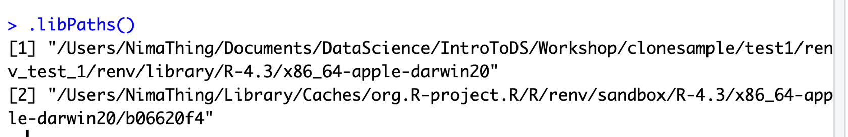
HERTIE
School
Search . . .
WHAT IS A LIBRARY PATH?
The function can be used to both retrieve and modify the library paths for your specific R session.
.libPaths()
User library: the folder where packages I choose to download and install normally get installed.
System library: the folder, where R’s default packages are stored normally.
Site library: other folders, where packages managed by administrators are stored

Slide 8
HERTIE
School
Search . . .
WHAT IS A LIBRARY PATH?
R looks through the active library paths one by one to locate an installation of the requested package.
It loads the first discovery it makes, including any required dependencies, all from these same library paths.
library(dplyr)
When this code is executed, R will inspect the active library paths to find an installed copy of the dplyr package and load the first one it encounters
If you want to manually search for an installed package, you can use
find.package()

Slide 9


HERTIE
School
Search . . .
THE CHALLENGE
By default, each R session uses the same set of library paths:
Library
Project 1
Project 2
Project 3
If dplyr 1.1.3 would be installed, this package would then become available for
all three projects.

Slide 10
HERTIE
School
Search . . .
THE CHALLENGE
Different Projects may have distinct package needs. For example:
Project 1 relies on dplyr version 0.9.
Project 2 needs dplyr version 0.8.2.
Project 3 demands the development edition of dplyr
The challenge is that all these projects share the same library paths, which means that installing a new version of dplyr would impact all these projects.
This could lead to confusion and potential issues, especially if you don't keep a record of which specific dplyr version (or its related dependencies) is associated with each project.

Slide 11
HERTIE
School
Search . . .
THE SOLUTION
Use project-local libraries to ensure that each project gets its unique library of R packages.
Library 1
Library 2
Library 3
Project 1
Project 2
Project 3
Utilizing project-specific libraries ensures that updating packages for one project won't risk the stability of your other projects.

Slide 12
HERTIE
School
Search . . .
THE SOLUTION
This concept of project-local libraries is the foundation of the renv package.
With renv, we:
Assign a dedicated project-specific library to each project.
Simplify the process of setting up and using these project-local libraries within R sessions.
Offer convenient tools for handling the R packages installed in these project-specific libraries.
Strive to ensure a smooth and user-friendly experience, even for those who are not experts in using renv.

Slide 13
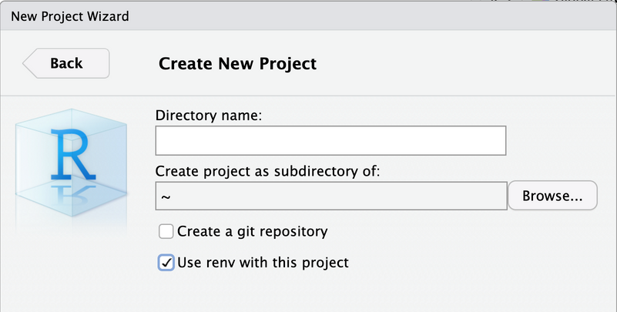

HERTIE
School
Search . . .
GETTING STARTED
The renv package helps you to create reproducible environments for your R projects [3].
01
INSTALLING RENV
install.packages(“renv”)
02
ALTERNATIVELY, YOU CAN CREATE RENV IN NEW PROJECT

Slide 14

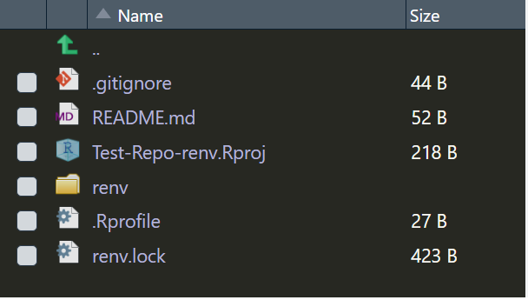
HERTIE
School
Search . . .
NEXT STEP
INITIALIZE NEW PROJECT ENVIRONMENT
renv::init()

Slide 15
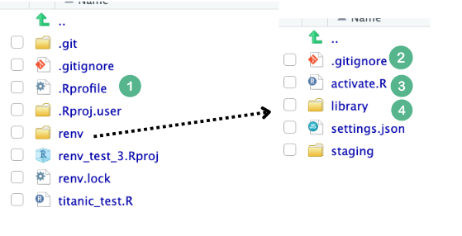
HERTIE
School
Search . . .
FILES AND FOLDERS CREATED BY RENV
.Rprofile
01
A file run by RStudio every time you load or reload R session. It calls the file.
renv/activate.R
renv/.gitignore
02
Tells Git to ignore the library folder, as it contains dependencies that can be large in size.
renv/activate.R
03
A file used to activate a local R environment.
renv/library/*
04
Folder with many subfolders –
contains the project dependencies.

Slide 16
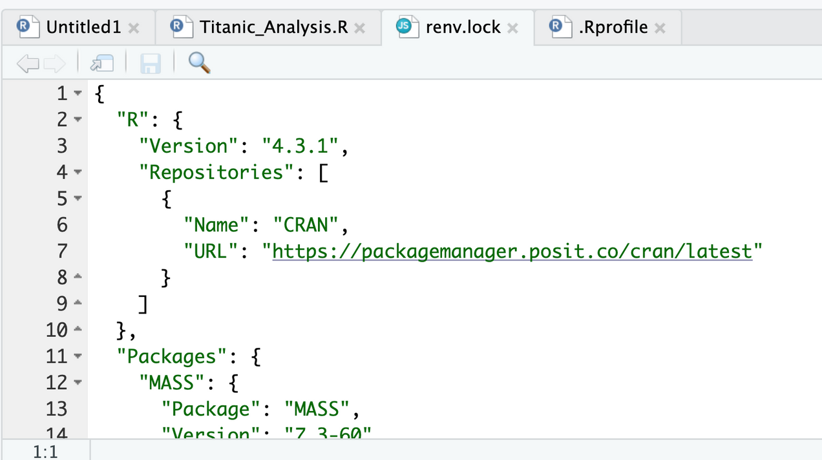
HERTIE
School
Search . . .
What’s inside renv.lock?
It contains all the project dependencies and sub-dependencies with the correct version.

Slide 17
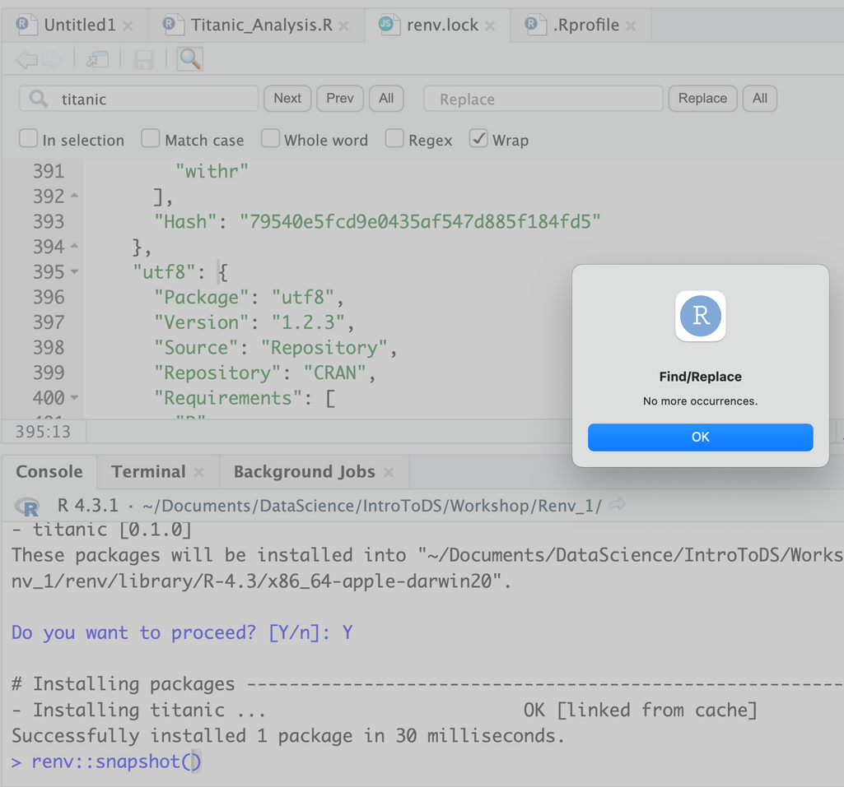


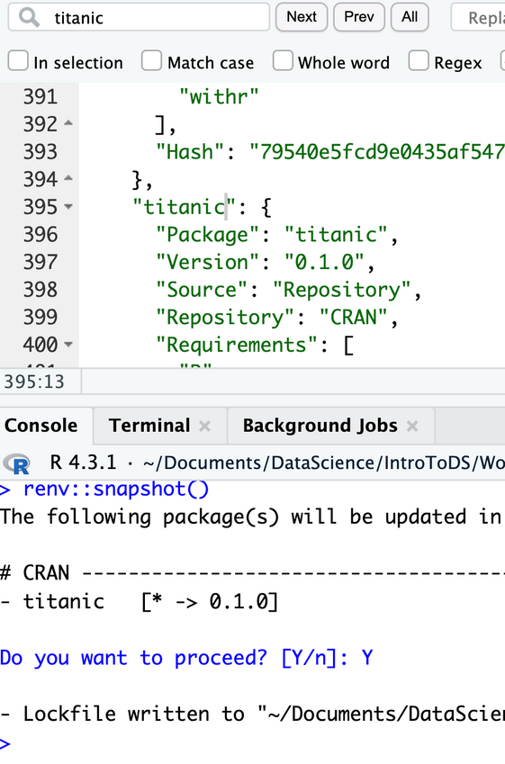
HERTIE
School
Search . . .
no dependencies? don’t worry!

Slide 18


HERTIE
School
Search . . .
Install and Save
INSTALL / REMOVE PACKAGES
SAVE LIBRARY
renv::snapshot()
install.packages()
renv::install()
remove.packages()
renv::remove()
or
or

Slide 19
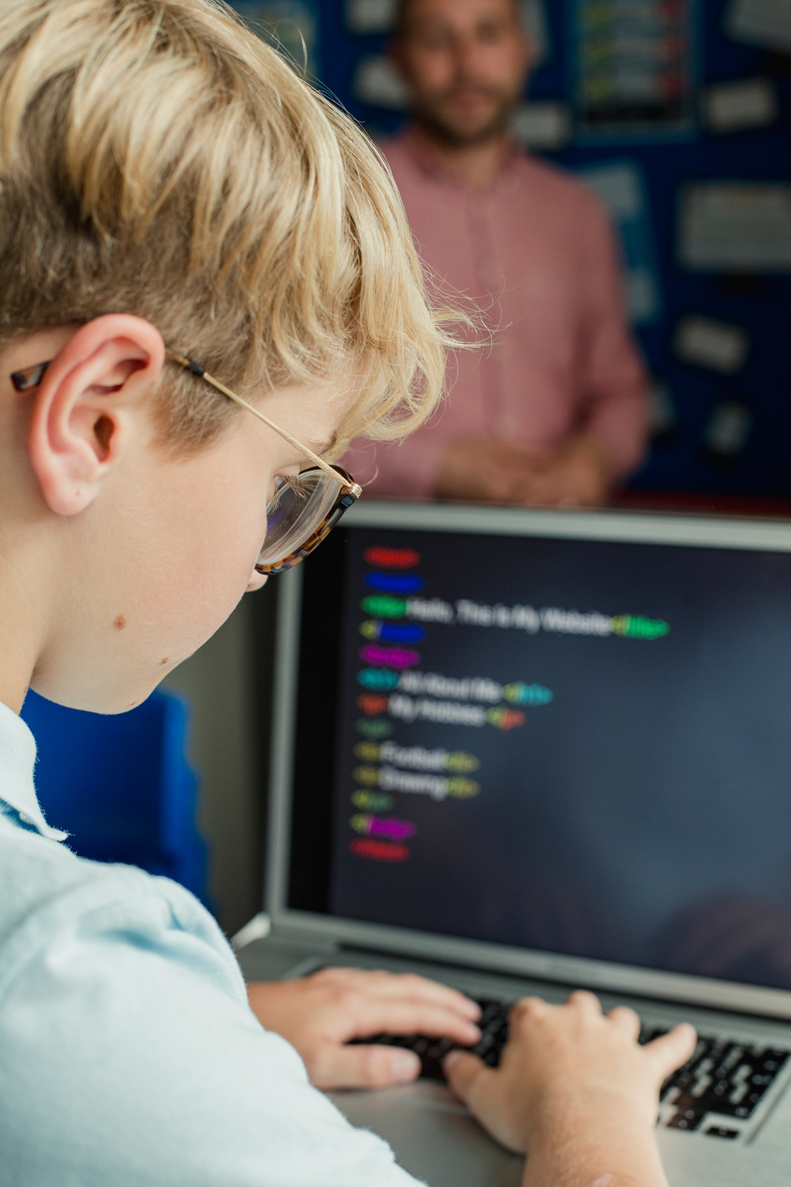
HERTIE
School
Search . . .
PUSHING RPROJECT TO GITHUB
git init
git add .
git commit -m "initial commit"
git remote add origin https://github.com/<you>/<project>.git
git push -u origin main

Slide 20
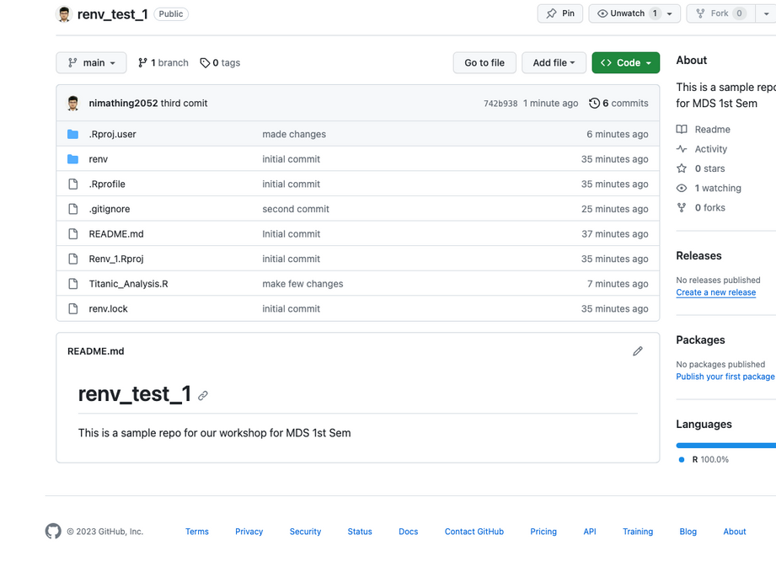
HERTIE
School
Search . . .
ASSUMING EVERYTHING WENT WELL

Slide 21
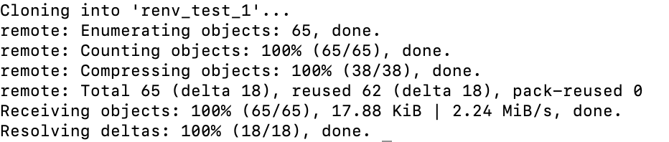
HERTIE
School
Search . . .
HOW TO RESTORE YOUR R ENVIRONMENT WITH
A SINGLE COMMAND
Start by cloning the repository into a new folder – NewRenvProject:
git clone https://github.com/<you>/<project>.git NewRenvProject

Slide 22
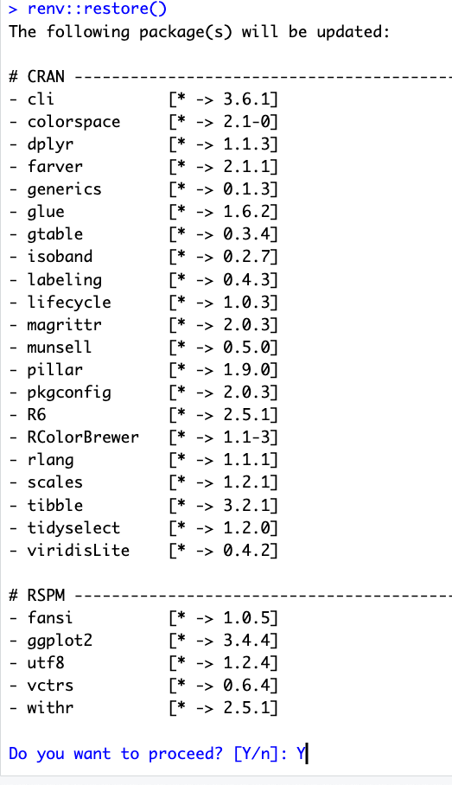
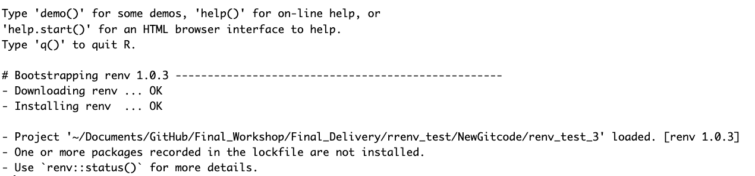
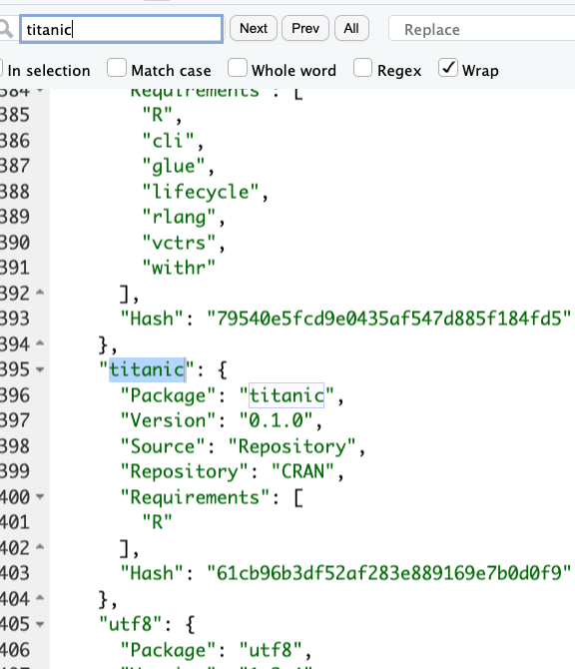
HERTIE
School
Search . . .
ONE MORE COMMAND
renv::restore()
Final lock file consisting all required dependencies
Now you are good to go!!!

Slide 23
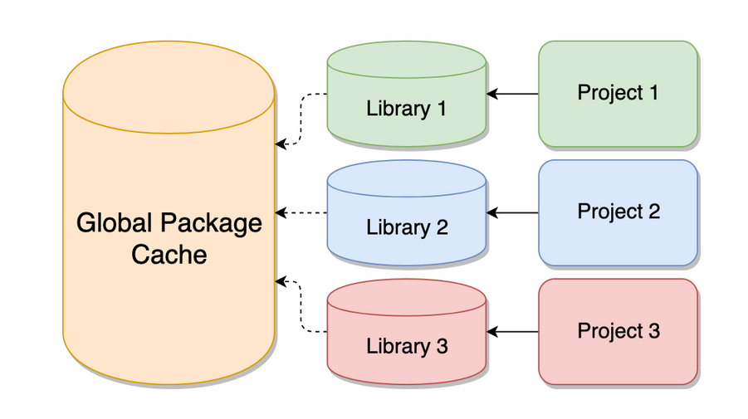
HERTIE
School
Search . . .
GLOBAL PACKAGE CACHE
renv also solves duplication issues with the use of global package cache.
When dplyr 1.1.3 is installed, renv will move that installation into the global cache,
and then link the installation into the project library as requested.

Slide 24
HERTIE
School
Search . . .
CAVEAT
R Version
01
renv tracks the package versions but doesn't handle the version of R itself. Consider tools like 'rig' to manage different R versions.
Pandoc Dependency
02
RMarkdown relies on Pandoc, which isn't bundled with the 'rmarkdown' package. Restoring 'rmarkdown' from the lockfile may not guarantee identical rendering of RMarkdown documents.
Operating System and Libraries:
03
renv doesn't address variations in the operating system, system library versions, or compiler versions. Docker is a popular solution for maintaining a stable environment.
Thoughtful Reproducibility:
04
Reproducibility isn't just about tools; it requires thoughtful consideration of project-specific goals and dependencies.

Slide 25
HERTIE
School
Search . . .
REFERENCES
RStudio (n.d.). "renv: Project Environments." [Webpage]. Retrieved from https://rstudio.github.io/renv/articles/renv.html
Kevin Ushey (2020). "Introduction to renv." RStudio Conference 2020 Slides. [Webpage]. Retrieved from https://kevinushey-2020-rstudio-conf.netlify.app/slides.html#18
Appsilon (n.d.). renv: How to Manage Dependencies in R. [Webpage]. Retrieved from https://appsilon.com/renv-how-to-manage-dependencies-in-r/?fbclid=IwAR3tXsTNdtzImNzVksza1xNb3tW8XAF4HR5DXrqL-PFjgbUb-MUbwRQV1zQ

Slide 26

HERTIE
School
Search . . .
THANK YOU

